Slide 1

Machine Learning
© Templateswise.com
Predicting - Food Demand
Or Dekel - 205784069
Yarden Dekel - 205784077
Rayee Peled - 312322134

Slide 2

The Problem
Prediction: Number of orders for a meal
Available Dataset: Historical sales data which include number of orders (Label), meal types, prices, center types and more..
Motivation / Application: To solve the supply chain disruption. In essence , avoid the risk of extra inventory wastage or being out of stock. as a result, lose potential customers.

Slide 3
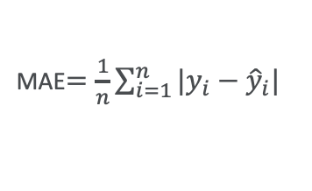
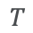
Evaluation
We will use MAE (Mean Absolute Error) Metric to evaluate the performance of an algorithm, We are interested in the total error aspect in order to maximize sales and growth.
To validate our model performance, with the fact that our solution demands prediction of the demand of food in the future with the help of the past , we non-random split the data.
MAE$=\frac{1}{n}\sum_{i=1}^{n}{|y_{i}−{\hat{y}}_{i}|}$
99%
1%
Train
Test
$$T$$

Slide 4
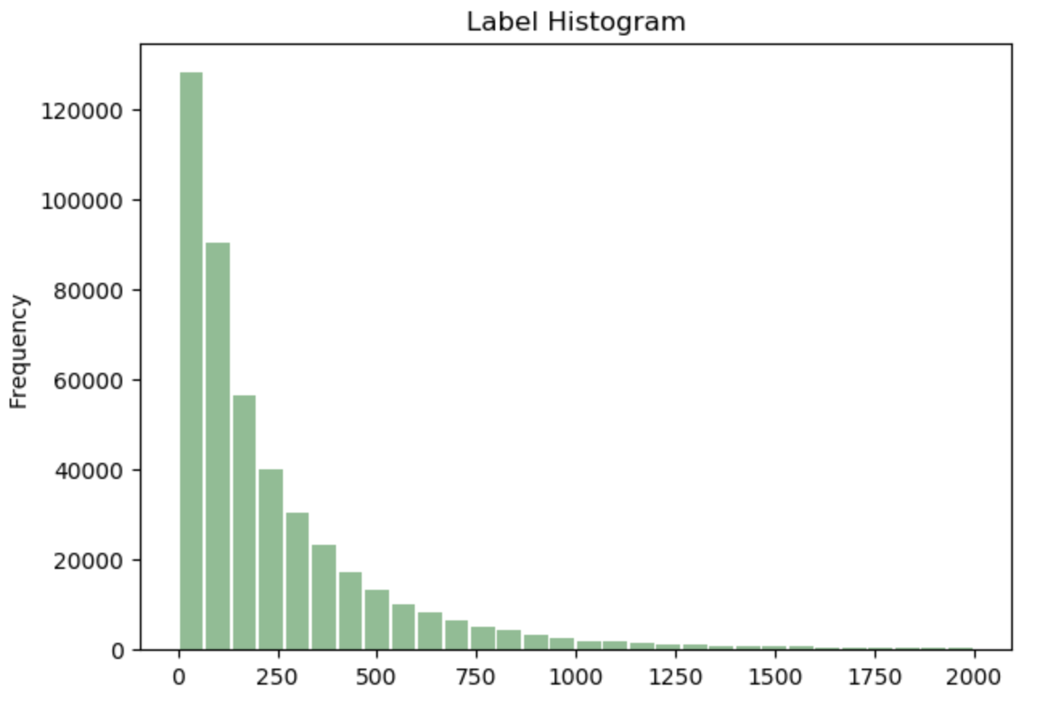
Data Description
Number Of Observations - 456,548
Training Set Observations – 451,982 Test Set Observations – 4,566 (last 2 weeks)
Number of Features – after get dummies 32
(1 of them is the label)
Missing values - None

Slide 5
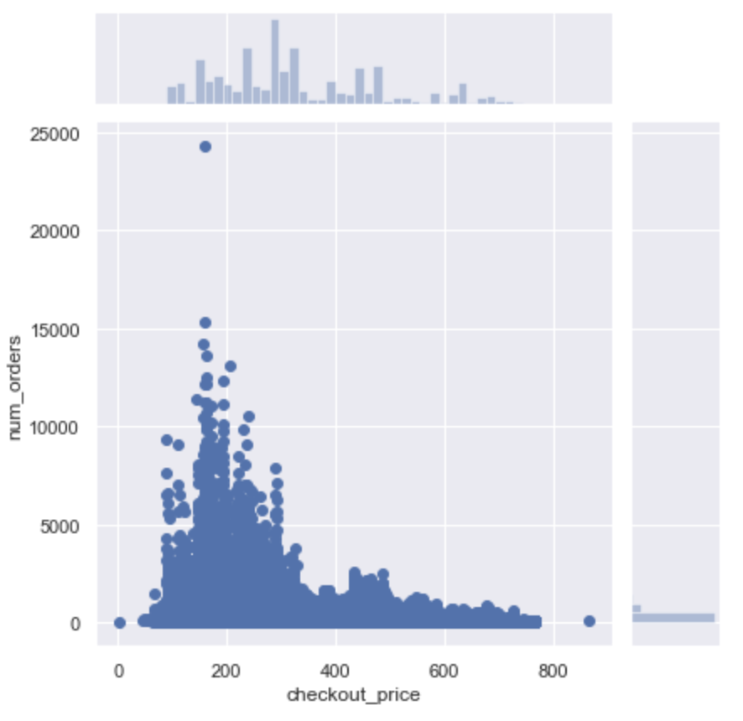
Number of Orders By Checkout Price
Most ordered meal Checkout price is 200

Slide 6
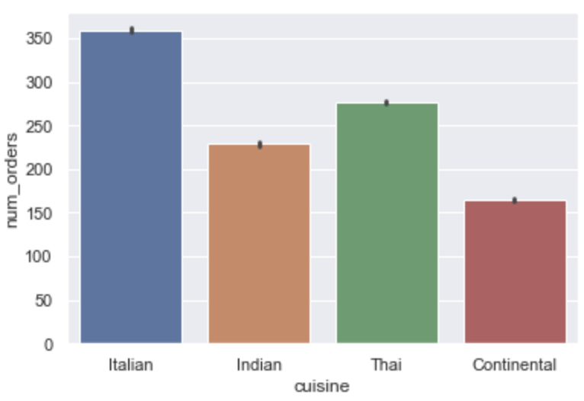
Number of Orders By Cuisine
Italian has the highest, while conteinental has the lowest number of orders

Slide 7
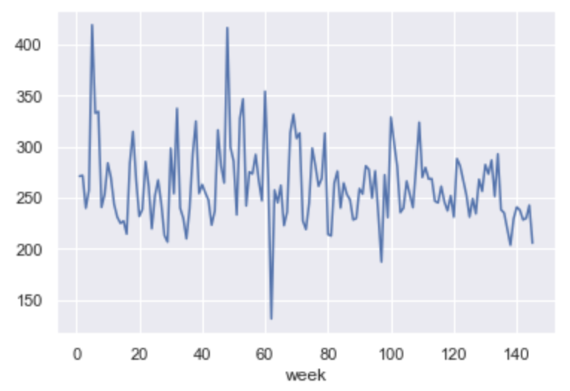
Number of Orders By Weeks
Week 5 and 48 have the highest orders
Week 62 has the lowest orders

Slide 8
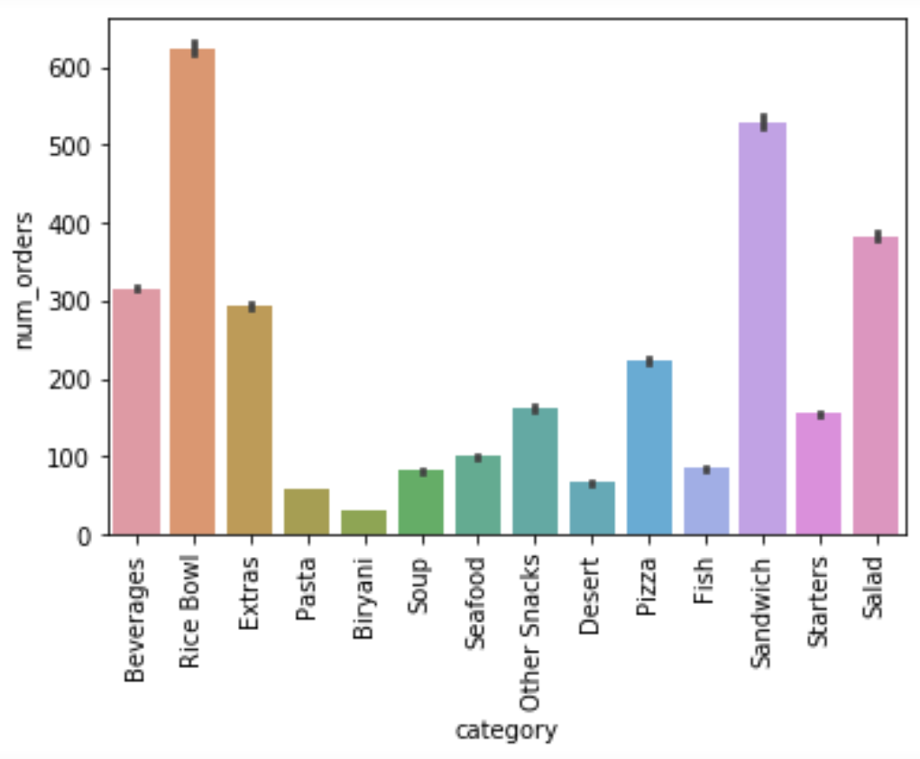
Number of Orders By Meal Category
Rice Bowl and sawndwiches are the most ordered meals

Slide 9
Data Engineering
- Features Removed – I.D
- Features added – None
- No missing values

Slide 10

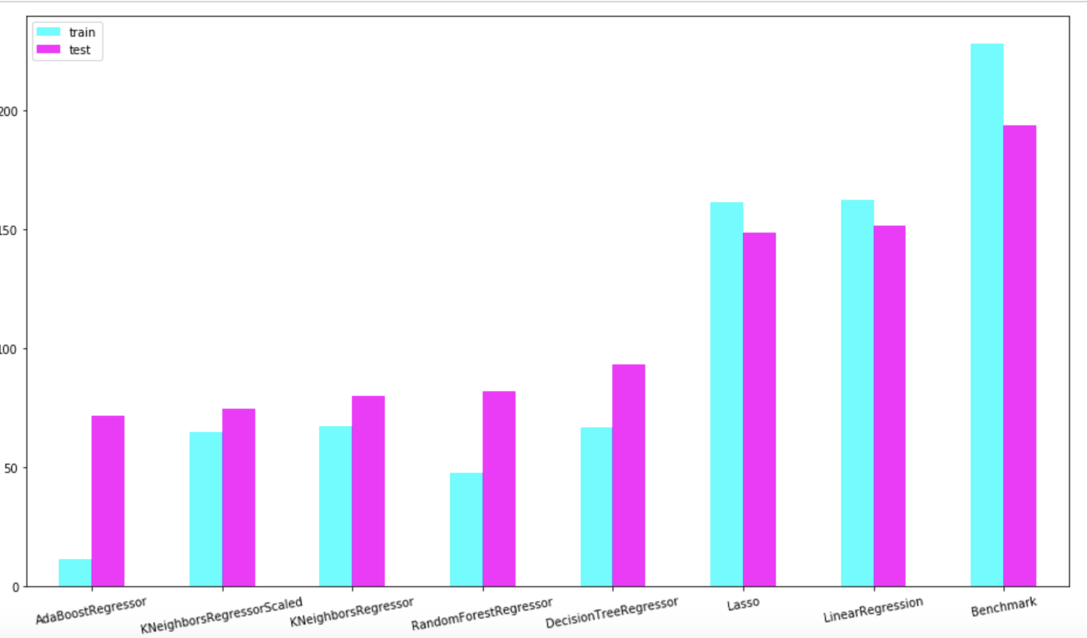
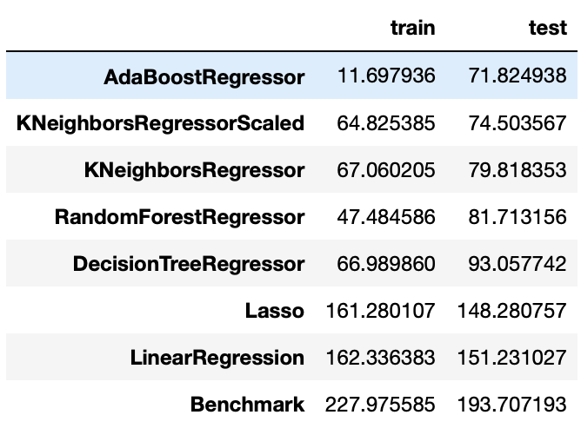
Algorithms performance
Notes:
i.e. avoiding the risk of wastage from extra inventory and the risk of being out of stock and lose potential costumers as a result.

Slide 11
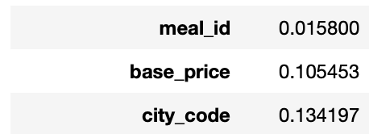
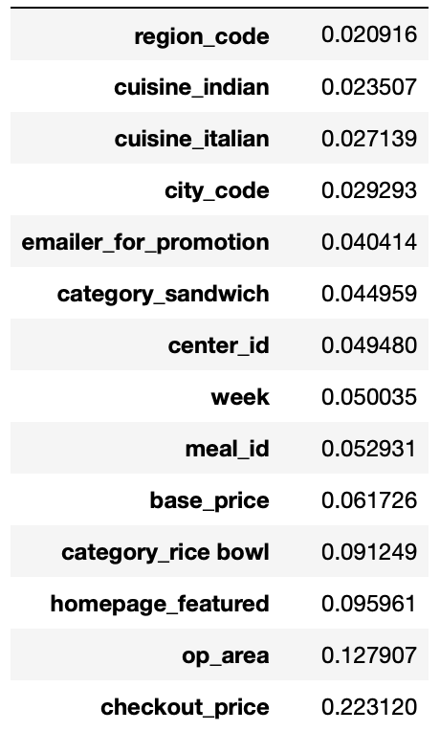
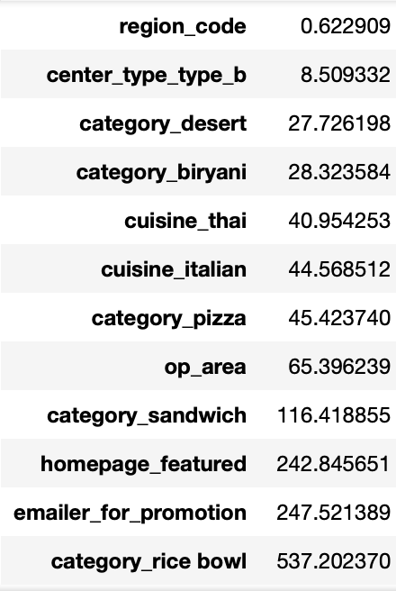
Algorithms introspection
Lasso coefs
Random Forest Important Feature
Hyperparameters:
Notes:
i.e. avoiding the risk of wastage from extra inventory and the risk of being out of stock and lose potential costumers as a result.

Slide 12
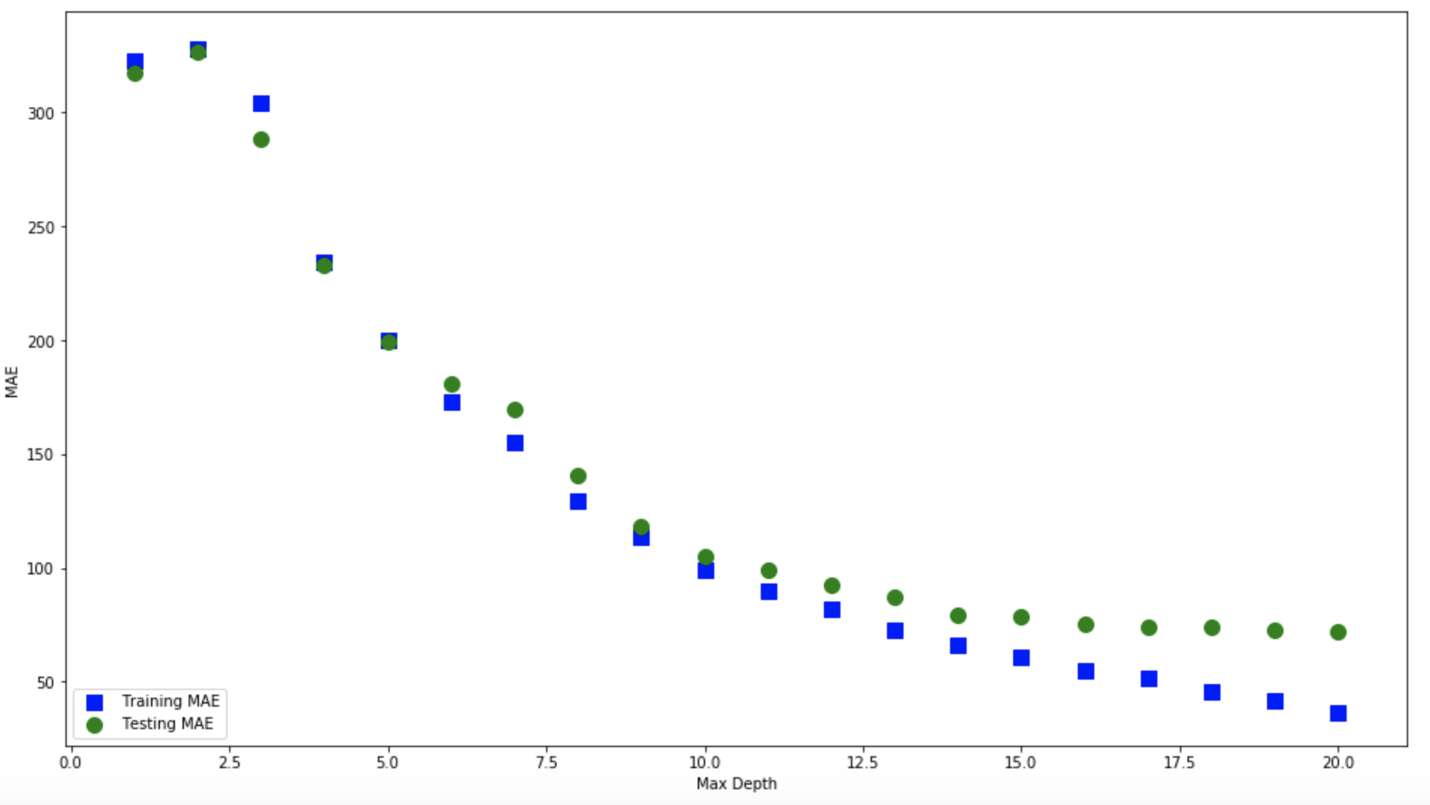
Hyper-parameters
AdaBoost based on decision trees
(different max depth)
Lowers AME for depth 17

Slide 13
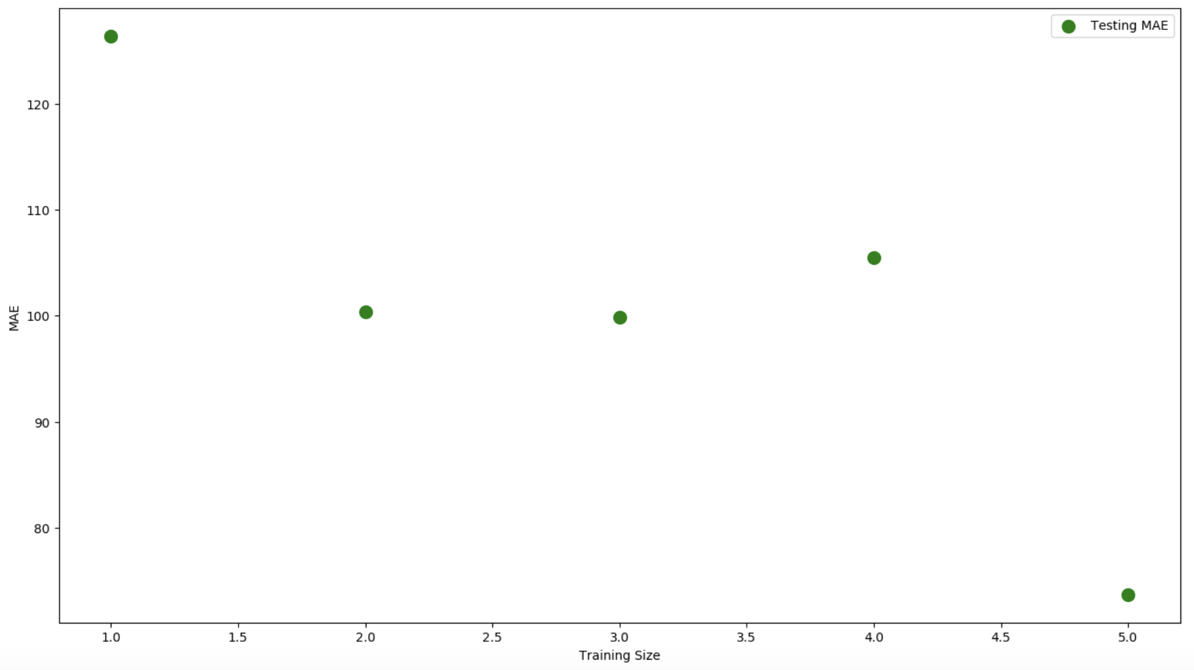
Additional Analysis
Performance vs amount of data [10%,30%,50%,70%,100%]
We don’t recommend to collect more data
Notes:
i.e. avoiding the risk of wastage from extra inventory and the risk of being out of stock and lose potential costumers as a result.

